Slide 1
RSM222 Management Accounting 1 Class 12: Reporting for Control
Elisa Zuliani

Slide 2
Learning Objectives
Differentiate among responsibility centres and explain how performance is measured in each.
•Cost centres, profit centres, and investment centres,
2.Analyze the return on investment.
3.Compute residual income and describe the strengths and weaknesses of this method of measuring performance.
4.Explain the use of balanced scorecards to assess performance.

Slide 3
What is Management Control?
How does this relate to last class?
Formulating long and short-term plans (Planning)
“Controlling is the measurement and correction of performance in order to make sure that enterprise objectives and the plans devised to attain them are accomplished.”
Harold Koontz
Comparing actual to planned performance (Controlling)
Implementing plans (Directing and Motivating)
Decision
Making
Measuring performance (Controlling)

Slide 4
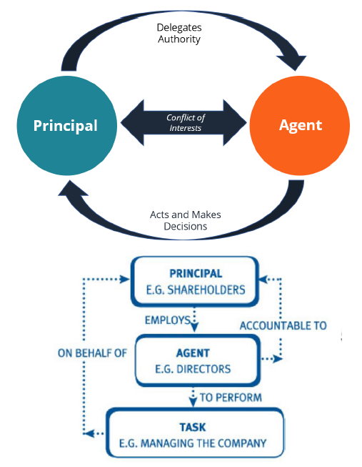
Why do we Need Control?
A principal-agent problem arises when there is a conflict of interest between the agent and the principal.
•The problem exists when the agent optimizes for themselves, as opposed to what’s best for the firm
•Shareholders vs. Employees
•Superiors and Subordinates

Slide 5
Management Control Process
All managers other than the CEO are both superiors and subordinates:
•they supervise the people in their own units,
•and they are supervised by the managers to whom they report
•The CEO
•(or, in some organizations, a team of senior managers)
•decides on the overall strategies that will enable the organization to meet its goals.
•Subject to the approval of the CEO,
•the various business unit managers formulate additional strategies that will enable their respective units to further these goals.
The management control process is the process by which managers at all levels ensure that the people they supervise implement their intended strategies

Slide 6
What are Management Control Systems?
The methods put in place to make sure the actual company performance is on track with company goals.
•Organization, policies, and procedures that influence the behavior of organizational resources to implement organizational strategies
•Once organizations reach a certain size, it becomes difficult for senior staff and other leading managers to give detailed instructions on how to perform each and every task
An effective control system ensures that activities are completed in ways that lead to the attainment of the organization’s goals.

Slide 7
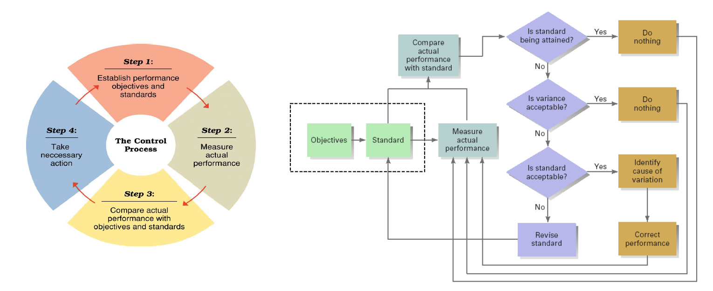
Management Control Process

Slide 8
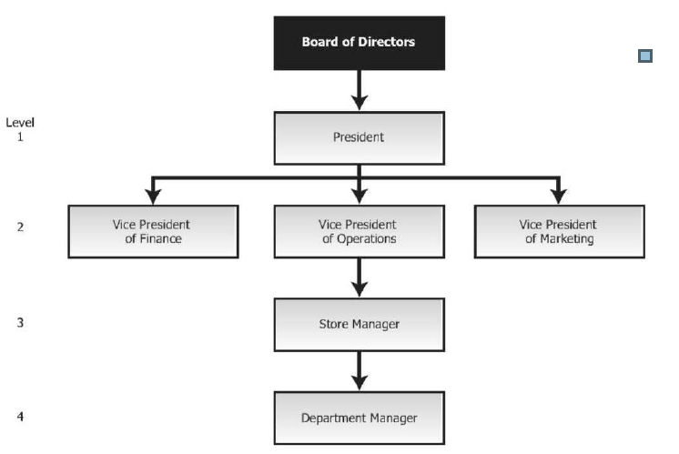
Responsibility Accounting
Companies divide their business into subunits
•Decentralization is the dispersion of decision-making authority among individuals at lower levels of the organization.
•Responsibility, accounting is a management control system based on the principles of delegating and locating responsibility
•It assigns “decision rights” to sub-units and provides information to evaluate each manager on what they have primary control over.

Slide 9

Decentralization in Organizations
Decisions at multiple levels
More flexibility
Faster action
Authority is disturbed

Slide 10
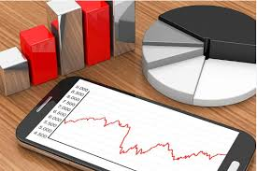
Segment Reporting
A Segment is any part or activity of an organization
A segment can be:
An individual store
A sales territory
A service centre

Slide 11
Levels of Segmented Statement
Common costs should not be allocated to the divisions. These costs would remain with the company even if one of the divisions was eliminated.

Slide 12
Traceable Fixed Costs vs. Common Fixed Costs
Traceable costs arise because of the existence of a particular segment and would disappear over time if the segment itself was eliminated.
Common costs arise because of the overall operation of the company and would not disappear if any particular segment was eliminated.
Common fixed costs are not allocated to segments.
11-12

Slide 13
Responsibility Centres
Managers should be held responsible for those items — and only those items — that the manager can actually control to a significant extent.
responsibility
Costs
Expense Center
responsibility
Revenue
Revenue Center
How do we evaluate?
Profit Center
responsibility
Revenue +Costs
responsibility
Revenue + Costs + Investment
Investment Center

Slide 14
Controllable vs. Non-Controllable Costs
Common vs. Traceable Fixed Costs? Discretionary vs. Committed Fixed Costs?
Arise because of the existence of a
particular segment and would disappear
over time if the segment itself disappeared
Controllable Costs
Arise because of the overall operation of
the company and would not disappear if
any particular segment were eliminated
Non-Controllable Costs
Managers are rewarded for what they control!

Slide 15
Performance Measurement
Performance measurement is a numeric outcome that indicates how well an organization is achieving its objective

Slide 16





Evaluating Performance
RESPONSIBILITY CENTER
Work / Performance
ALIGNMENT
Compensation
COMPANY
OBJECTIVES
EMPLOYEES
PERFORMANCE MEASURES WILL BE PUT IN PLACE TO EVALUATE
PERFORMANCE.

Slide 17
Evaluating Responsibility Centers
Responsibility Centre | Evaluation Basis
Expense Center | Minimizing costs for a fixed level of output Managing budget
Revenue Center | Maximizing revenues, number of orders / units sold
Profit Center | Target Profit (Contribution Margin – Traceable Fixed Costs)
Investment Center | ROI (Operating Income/Avg. Operating Assets) Residual Income (operating income - (minimum required return x average operating assets)
Why are these appropriate?

Slide 18
Types Performance Measures
Based on financial information such as financial statements, ratios or other monetary amounts.
Financial Measures
Non-Financial Measures
Any quantitative measure of performance that is not expressed in monetary units.
Financial performance measurement →Short-term success factors
Revenues, profits and cash flows of the company.
Non-financial performance measurement → Long-term strategic success of an organization.
Satisfaction of customers and their retention, brand development, employee motivation, the capacity of organization, market share etc.

Slide 19
How to come up with good performance measures?
S
Specific: What is to be accomplished?
Measurable: How can the objective be evaluated (#,
%, rating…)?
M
A
Achievable: Can the person do it?
Relevant: Is it congruent with the company’s
objectives?
R
T
Timely: When can the results achieved?

Slide 20
Financial Measures of Performance

Slide 21


Return on Investment (ROI)
RELATIVE MEASURE!!!
OPERATING INCOME
Operating Income ≠ Net Income
Avg. Operating Assets:
Includes cash, AR, Inventory, PP&E and all other assets used in production.
Exclusions would include land held for future use (redundant asset) or investment in other companies…
EBIT
AVERAGE OPERATING ASSETS
ROI tries to directly measure the amount of return on a particular investment, relative to the investment’s cost

Slide 22
Cost vs. Book Value
Most companies use the net book value of depreciable assets to calculate average operating assets
To compute the operating assets, should we use the book value or the cost of the
PP&E?
Book Value:
Consistent with Financial Reporting
Consistent with computation of NI.
OPERATING INCOME
Cost (Gross Method):
AVERAGE OPERATING ASSETS
Ignores the age of the asset → more
stable over time
Doesn’t discourage replacement of old equipment.

Slide 23
Criticisms of ROI
In the absence of the balanced scorecard, management may not know how to increase ROI.
Managers often inherit many committed costs over which they have no control.
Managers evaluated on ROI may reject profitable investment opportunities.
OPERATING INCOME
AVERAGE OPERATING ASSETS

Slide 24
ROI
Asset Turnover = Total Revenue
Investment
Asset turnover measures the efficiency of the division’s use of its investment (i.e., operating asset).
Asset turnover increases as the division uses its investment more efficiently., services, or intangible assets
Profit margin = Net Income
Total Revenue
Profit margin measures the profitability of the division.
Profit margin increases, if the division’s total costs per total revenue decreases (i.e., if the division generates the same revenue with less costs).
ROI = Net Income = Net Income x Total Revenue = Profit x Asset
Investment Total Revenue Investment Margin Turnover

Slide 25





How can you increase ROI?
Increase Sales
OPERATING INCOME
Reduce Operating Expenses
AVERAGE OPERATING ASSETS
Reduce Operating Assets

Slide 26



Residual Income (RI)
ABSOLUTE MEASURE!!!
AVERAGE OPERATING ASSETS
MINIMUM
X REQUIRED RATE
OF RETURN
OPERATING INCOME
-
Operating income above some minimum return on operating assets
Residual income encourages managers to make profitable investments that would be rejected by managers using ROI.
WHY?
Issue: Cannot be used to compare performance of divisions of different sizes.

Slide 27
Other Criticisms of Residual Income (RI)
AVERAGE OPERATING ASSETS
MINIMUM
X REQUIRED RATE
OF RETURN
OPERATING INCOME
-
RI is based on historical accounting data which can lead to inflated amounts for residual income in periods of rising prices (i.e.. values for capital assets).
RI does not indicate what earnings should be (need comparison of external benchmark or trends).
RI does not incorporate important leading non-financial indicators.
Does ROI?

Slide 28
The Balanced Scorecard and Non-Financial Measures

Slide 29

The Balanced Scorecard
https://www.youtube.com/watch?v=0zbhEpYwBCY&ab_channel=SpiderStrategies
The balanced scorecard does the following:
"Apple strives to bring the best personal computing experience to students, educators, creative professionals, and consumers around the world through its innovative hardware, software, and internet offerings."
Employs both financial and nonfinancial measures.
Creates linkages so high-level corporate goals can be communicated
Provides measurable objectives for nonfinancial measures such as product quality.
Integrates company’s goals into a single performance measurement system.
Are Financial
Measures enough?

Slide 30
The Balanced Scorecard (cont’d)
Management translates its strategy into performance measures that employees understand and accept.
Indicator 1
Indicator 2
Indicator 3
Indicator 1
Indicator 2
Indicator 3
How does this help measure performance against strategic goals?
Financial
Customer
Organizations often fixate on a single measure of performance
The balanced scorecard suggests what the key indicators should be, and provides a method for identifying specific measures and goals, translated from a particular unit’s vision or strategy.
Internal Processes
Learning & Growth
Indicator 1
Indicator 2
Indicator 3
Indicator 1
Indicator 2
Indicator 3

Slide 31
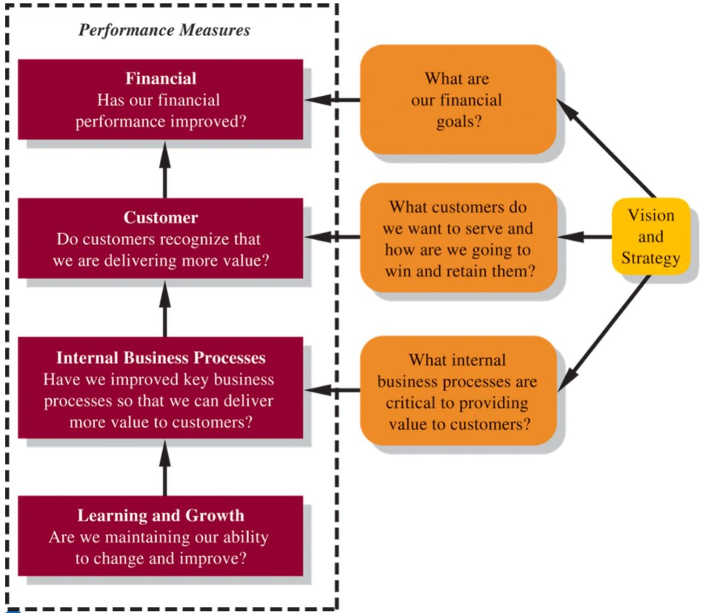
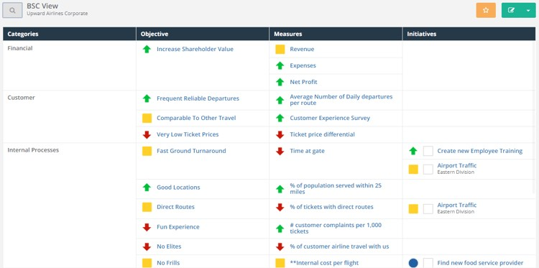
From Strategy to Performance Measures
Financial measures are lag indicators that summarize the results of past actions. Non-financial measures are leading indicators of future financial performance.
Should the measures be easily attainable?

Slide 32

Class Motivation
Childrens-Aid foundation has strategic priorities

Slide 33
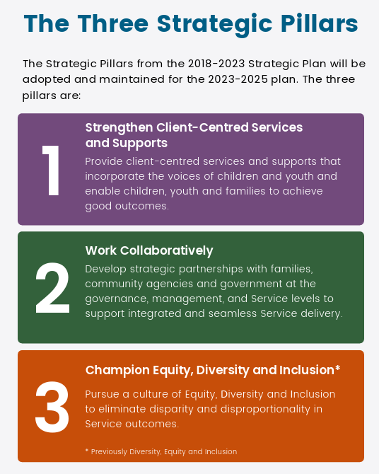
Class Motivation
Childrens-Aid Society of Toronto
Strategic Plan – 2023 - 2025
“How do you ensure business strategic objectives are being achieved? It's all about tracking and measuring. As they say, if you can measure it, you can improve it. To actually measure and track business objectives, you'll need the right KPIs.”
Cascade Strategy

Slide 34
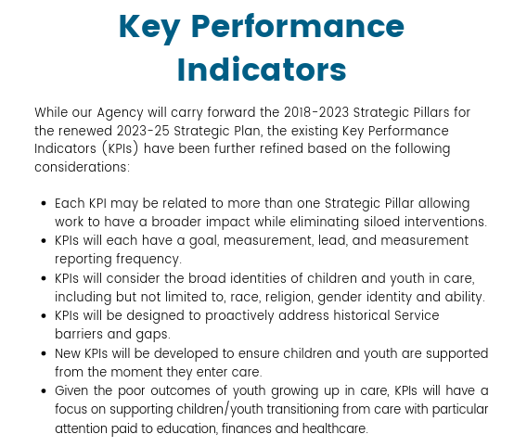

Class Motivation
Taken from the Children’s-Aid Society of Toronto Strategic Plan 2023-2025

Slide 35
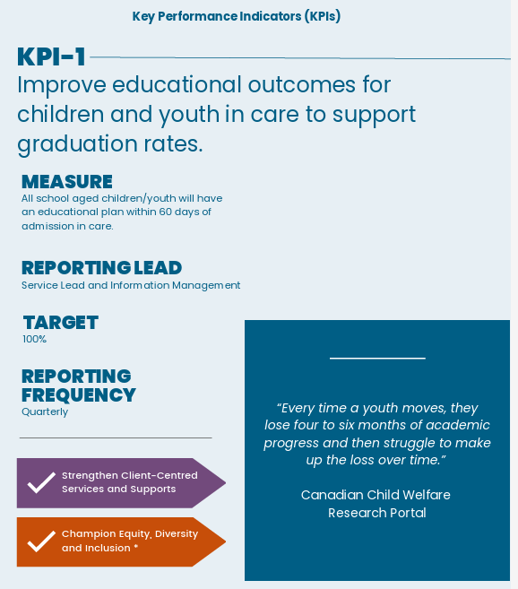
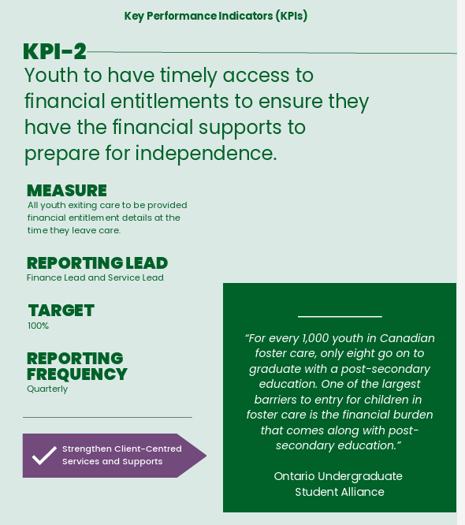
Class Motivation

Slide 36
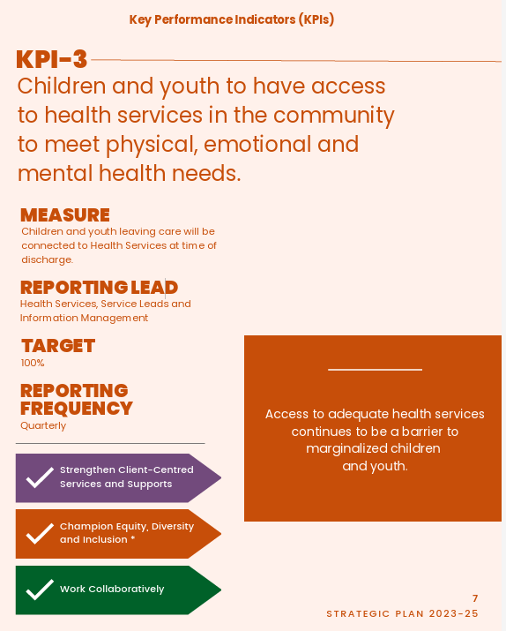
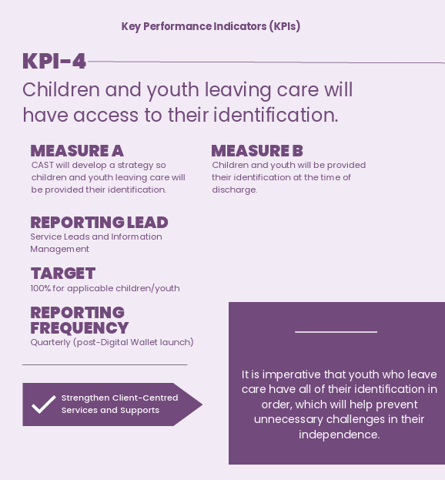
Class Motivation

Slide 37
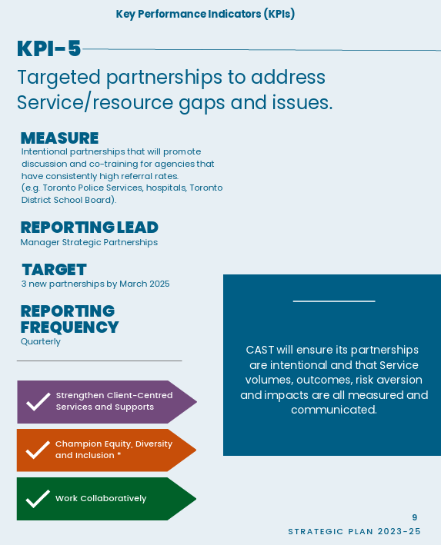
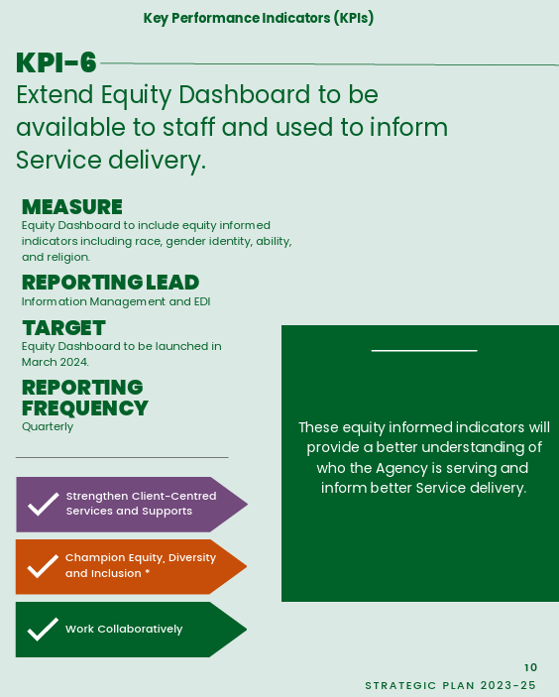
Class Motivation

Slide 38
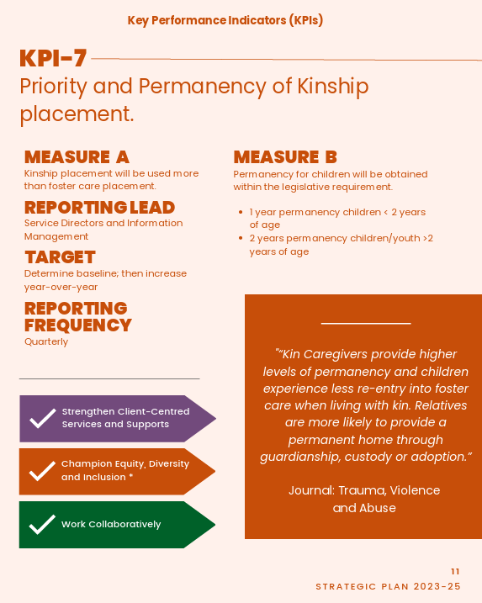
Class Motivation

Slide 39
IN CLASS EXAMPLE
Performance Measures

Slide 40
Any Questions?

